Slide 1
Life is Short: How Python Can Help Developing Intermittent System
PunchShadow
PyCon TW 2020
Sept 5, 2020
Notes:
Title: 報告主題
Speaker's Name: 報告者的名字
Report Type: 填入報告類型, 例如: Paper Survey 或 Progress Report
Month Day, Year: 報告日期, 例如: Aug 10, 2012

Slide 2

Who Am I ?
PunchShadow (謝宙穎)
PhD student of NTUEE
Research domain:
System & mircoarithecture design
Non-volatile memory
Contact me
NTU BL607
Email: f07921043@ntu.edu.tw

Slide 3
Outline
Introduction to Intermittent Computing
Background
Challenges
How Python Can Help
Gem5
pvlib
Appendix – Related Works

Slide 4

What Causes Computing Intermittent ?
Let’s talk about Internet-of-Thing (IoT) first !

Slide 5
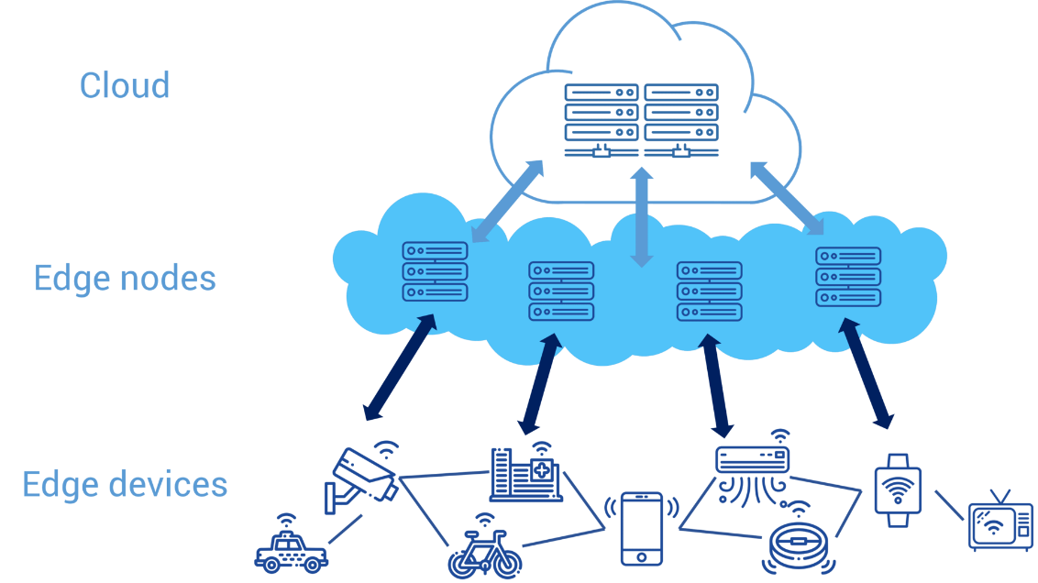

Wait A Minute …
Have you ever considered about where the power of devices from ?
Wire ? Battery ?
It’s impossible that all the edge devices could be connected through wire

Slide 6
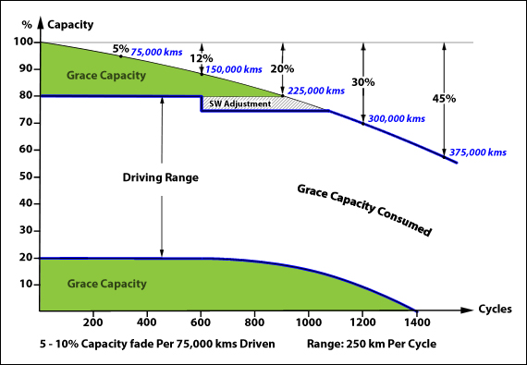
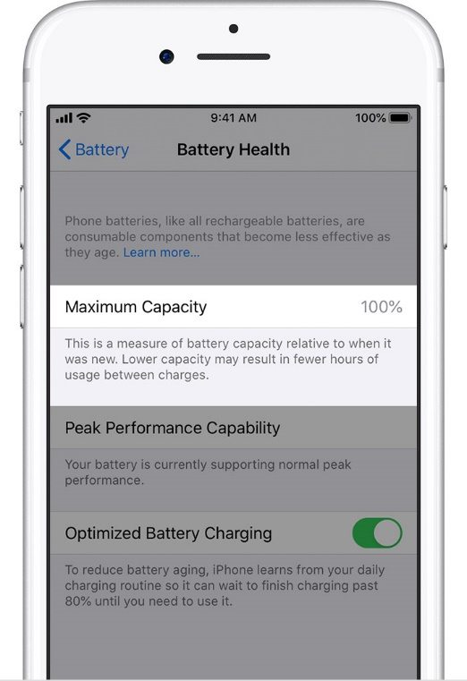
What’s The Problem of Battery ?
Have you ever feel your Iphone lack of power more and more quickly ?
THAT’S BATTERY AGING

Slide 7
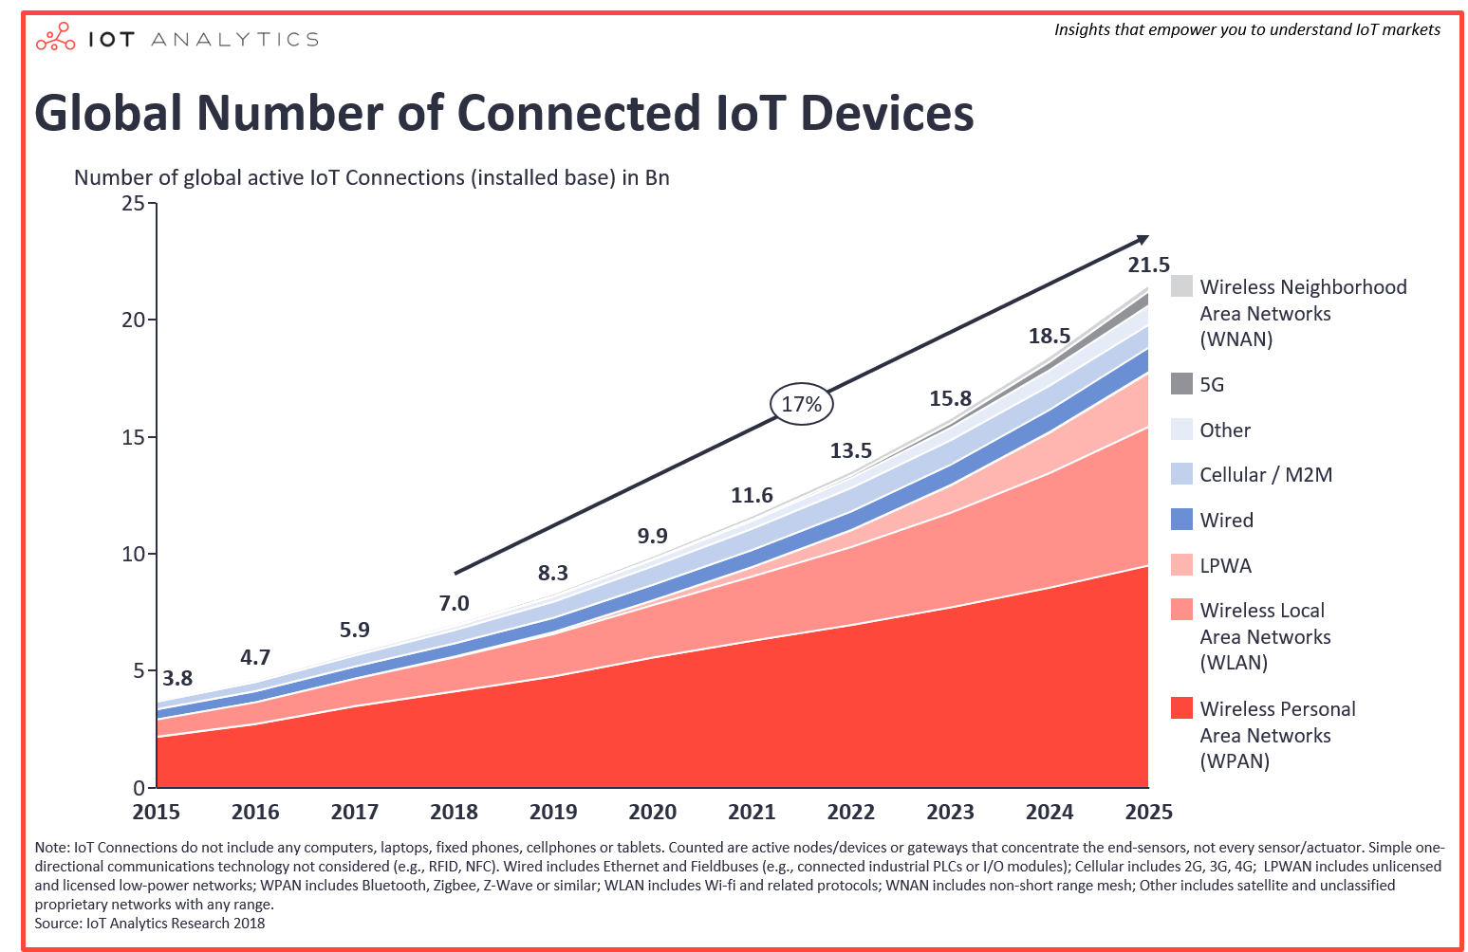
Why Don’t We Just Replace It ?
It’s available on our mobile phones, notebooks or vehicles.
But image if we have to change billions of devices which are deployed at the rainforest or inside our bodies ?
Maintaining costs too much

Slide 8
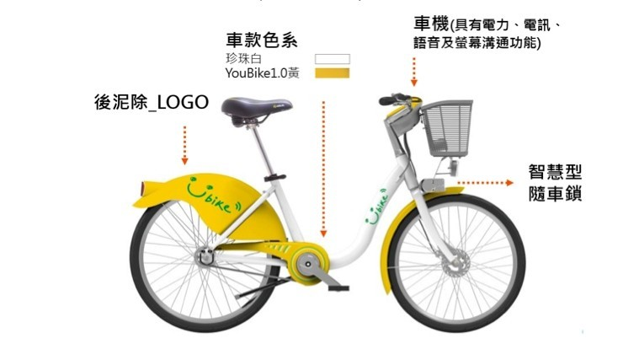
Here Comes Energy Harvester
Energy harvesting is the capture and conversion of small amounts of readily available environment energy into usable electrical energy
Light energy: From sunlight or artificial light
Kinetic energy: From vibration, mechanical stress or strain
Thermal energy: Waste energy from heater, friction, engines,..
RF energy: From RF signals

Slide 9
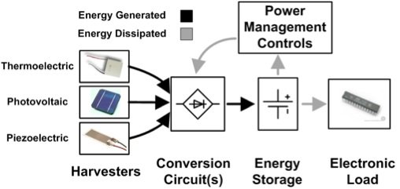
Building Blocks of an Energy Harvesting
Use small battery or super capacitor to temporarily store the power which can offer the processing
Smaller the capacitor, the more insignificant the aging problem is.

Slide 10
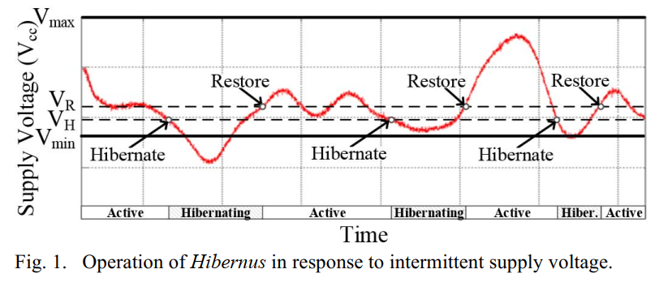
It Turns to Other Problems
The reducing of capacitor makes the power supply unstable due to the rapid changing environment -> Intermittent power supply
Our target is to make processes execute correctly and efficiently under this condition.
[1]
[1] Hibernus: Sustaining Computation During Intermittent Supply for Energy-Harvesting Systems
Notes:
[Fig.1 ] Hibernus: Sustaining Computation During Intermittent Supply for Energy-Harvesting Systems

Slide 11
The Challenges We Face
Liveness Problem
Correctness Problem
Consistency Problem
Efficiency Problem

Slide 12
Liveness Problem
Could finish a conventional program under intermittent system ?
Checkpoint-based: statically or dynamically store data to non-volatile storage
Task-based: Split large program to several small idempotent piece of atomic tasks
Non-volatile memory based: Totally execute process on non-volatile memory or processor
E.g. Disk/ SSD/ FRAM/ ReRAM/ MRAM

Slide 13
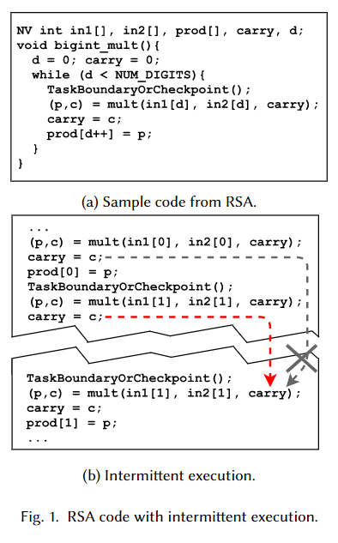
Correctness Problem
Write-After-Read (WAR) problem
Read and write at the same memory location will have WAR dependency
Once the modified data have already stored in non-volatile memory, but the CPU doesn’t know it.
Solution: data versioning, idempotent section…
[3] Alpaca: Intermittent Execution without Checkpoints

Slide 14
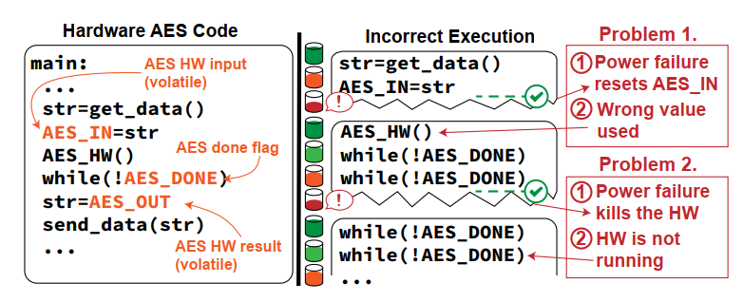
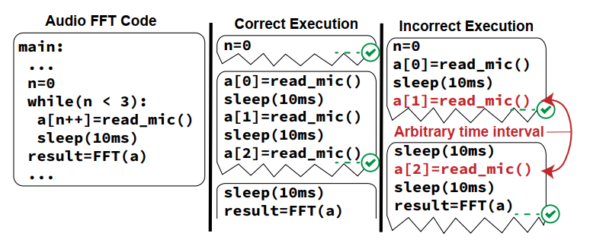
Consistency Problem
CPU/MCU’s state can be checkpointed, but the peripheral devices’ state can’t be recorded.
Incorrect results
Infinite wait
Timeliness and signal consistency
[3] Support Peripherals in Intermittent Systems with Just-In-Time Checkpoints

Slide 15
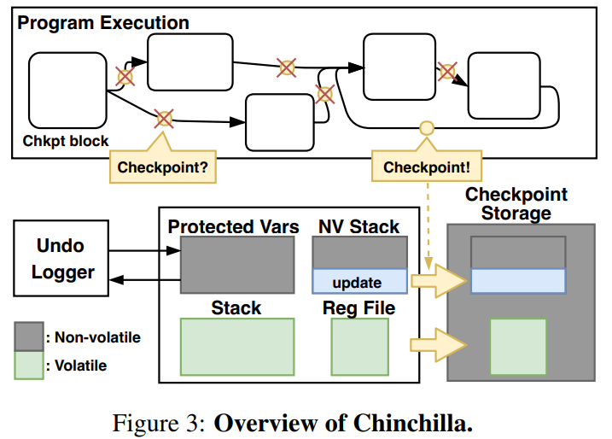
Efficiency Problem
How and when to make a checkpoint is the best ?
Re-execution cost vs. checkpoint overhead
Which data we have to record ?
How to hide the long latency of non-volatile memory write ?
[4] Adaptive Dynamic Checkpointing for Safe Efficient Intermittent Computing

Slide 16
When It Comes to Development
Environment
Variable energy sources
Energy harvester design
Acquire energy
Hardware Architecture
Runtime issue
Software Application
cooperation
Energy management
Crash consistency
Performance enhancement
NVM properties
Profiling
User resilient programming
Energy-aware framework
Crash consistency
OS/lightweight kernel support
Domain-specific questions

Slide 17
Prior Method
+
+
Low power development board
Energy harvester
Re-compile the program
Take a lots of time on experiments
Constraint to design on hardware architecture
Hard to get the analysis data

Slide 18
So What We Suggest Is...
+
+
simulator
Energy trace model
Re-compile the program
Or change micro-op in gem5
Fast to implement and easy to get the analysis data within gem5
Is flexible on micro-architecture design

Slide 19
PVlib
A Python package to simulate the performance of photovoltaic energy systems
Convert TMY(Typical meteorological year) file to power trace
Can customized some parameters, e.g. airmass, altitude,…

Slide 20
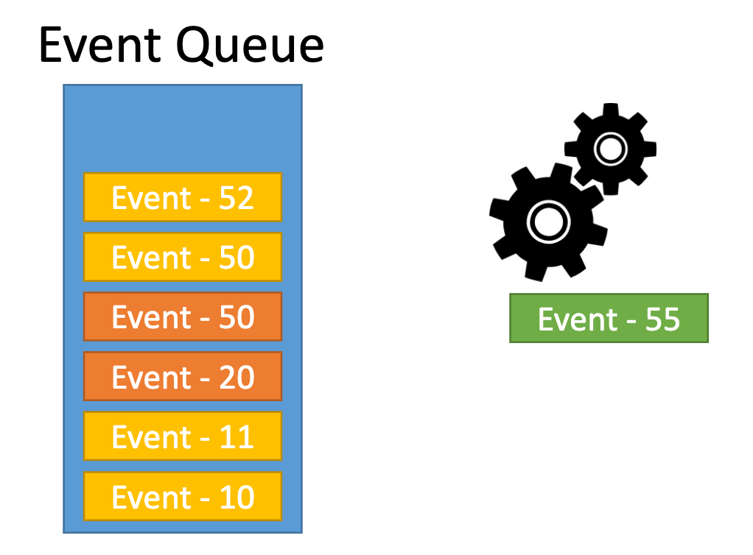
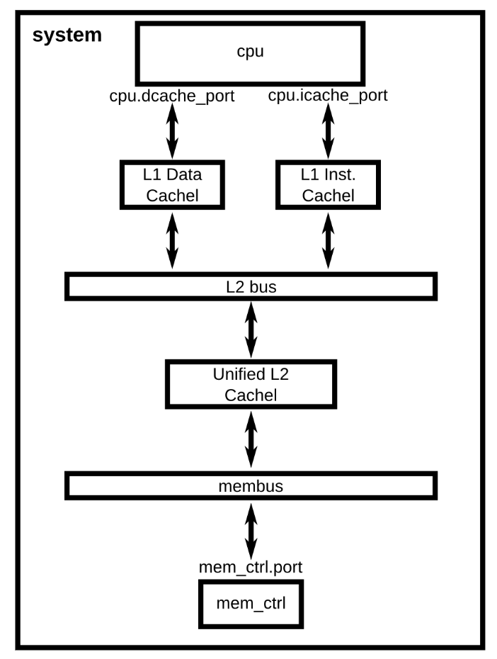
gem5 Architecture
A modular platform for computer-system architecture research.
A discrete event simulator
Use C++ object to represent physical system components
Completely controlled by Python Script
Script define system to model
All C++ objects exposed to Python
Source: http://learning.gem5.org/

Slide 21
gem5 Architecture
Modification on
architecture
Python Script Configuration
API
SCons
pybind11
build
call
return
Object
Object
Object
Object
Object
C++

Slide 22
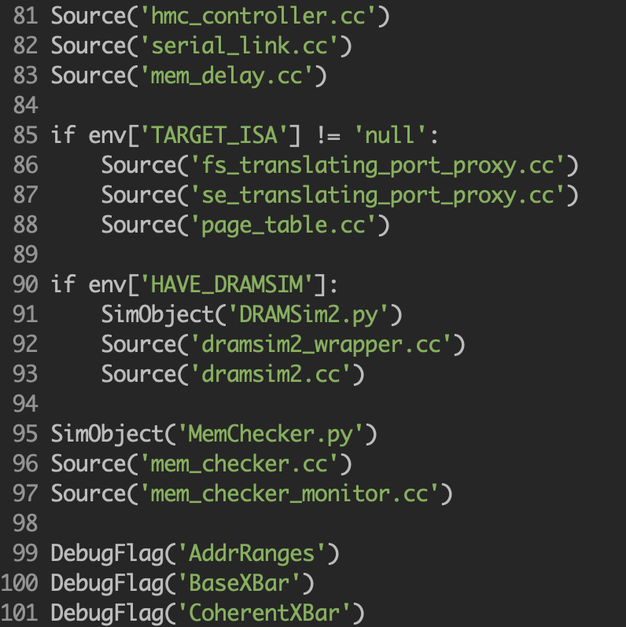
SCons
A next-generation build tool.
Written in Python to support a variety of user interfaces
Customized Define target
SimObject(‘DRAMSim2.py’)
Be careful when using Python2.7

Slide 23
Pybind11
pybind11 is a lightweight header-only library that allows interacting with Python interpreter and writing Python extension modules in modern C++
No dependencies, doesn’t require specific build tools
Support almost every STL and class in C++
Source: Integrate Python and C++ with pybind11 - Robert Smallshire

Slide 24
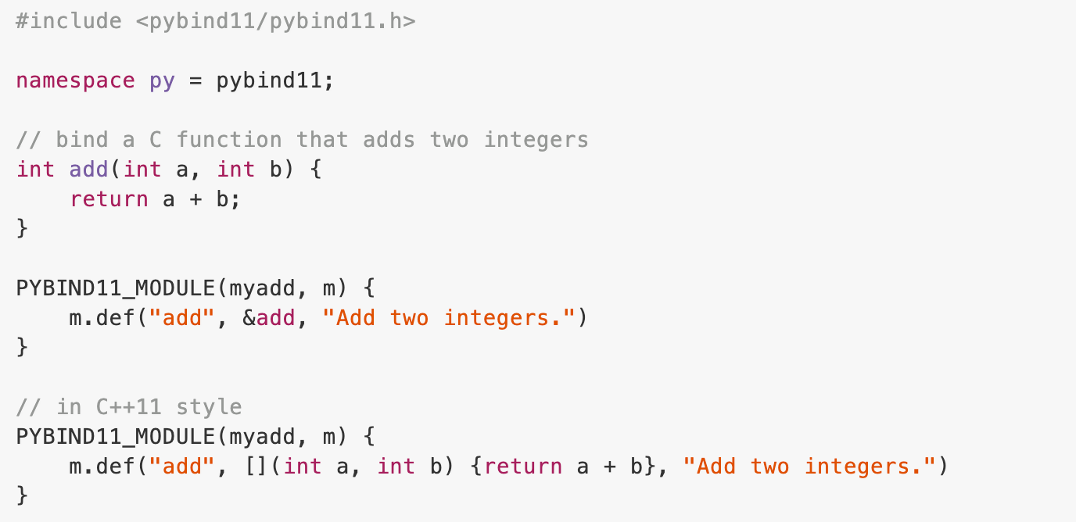
Pybind11 Example

Slide 25
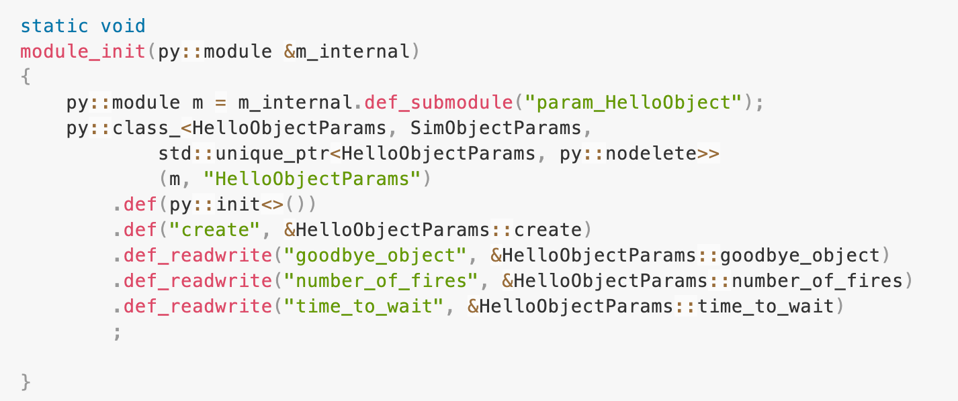
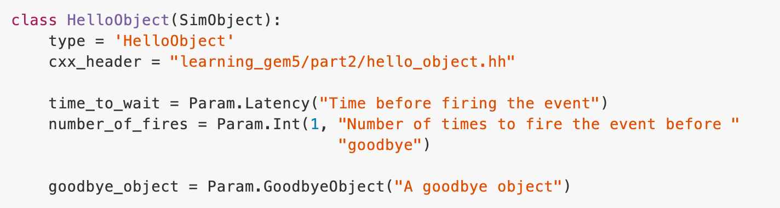
Object in pybind11
C++
Object inheritance
Python

Slide 26
Object in pybind11
C++
Function
Python

Slide 27
Object in pybind11
C++
Read/ writeable parameter
Python

Slide 28
Magic of pybind11 in gem5
The py::module’s code is auto-generated by Python and Scons !!!!
Python
Class
Scons
M5 parser
Pybind module
scan
pass
C++
Object
Function transfer

Slide 29
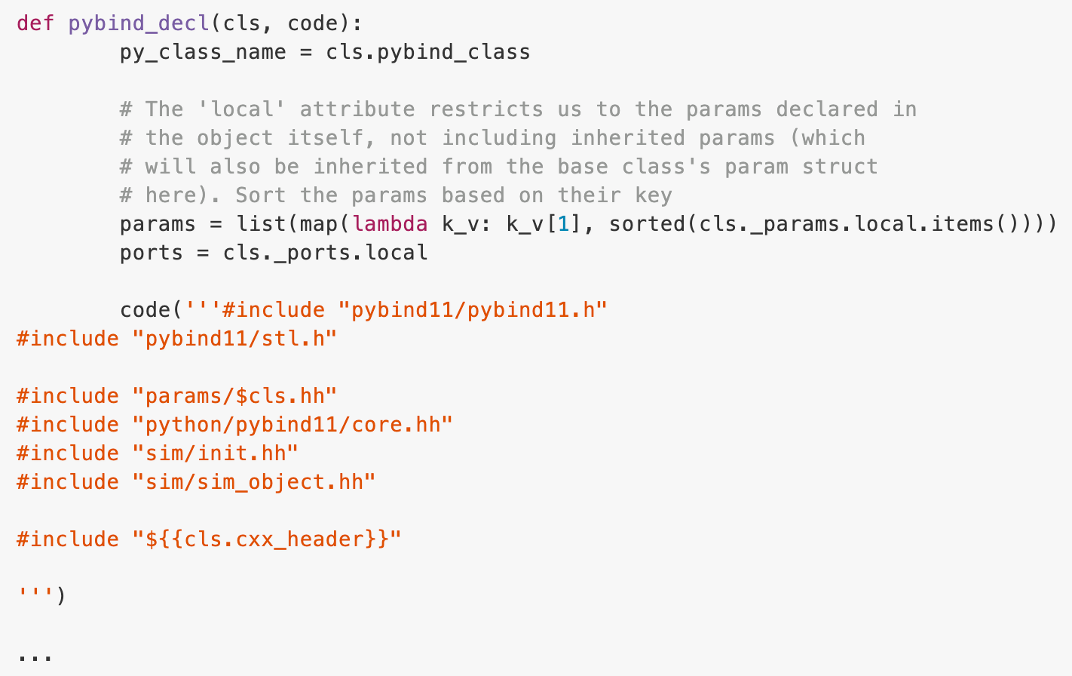
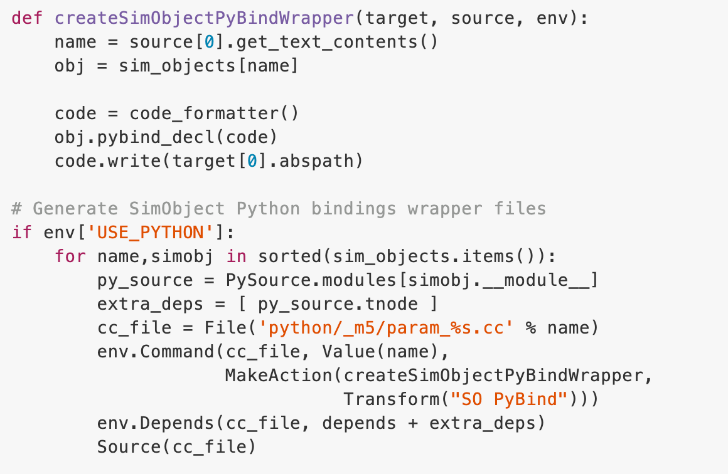
Magic of pybind11 in gem5

Slide 30
More Details About pybind11

Slide 31
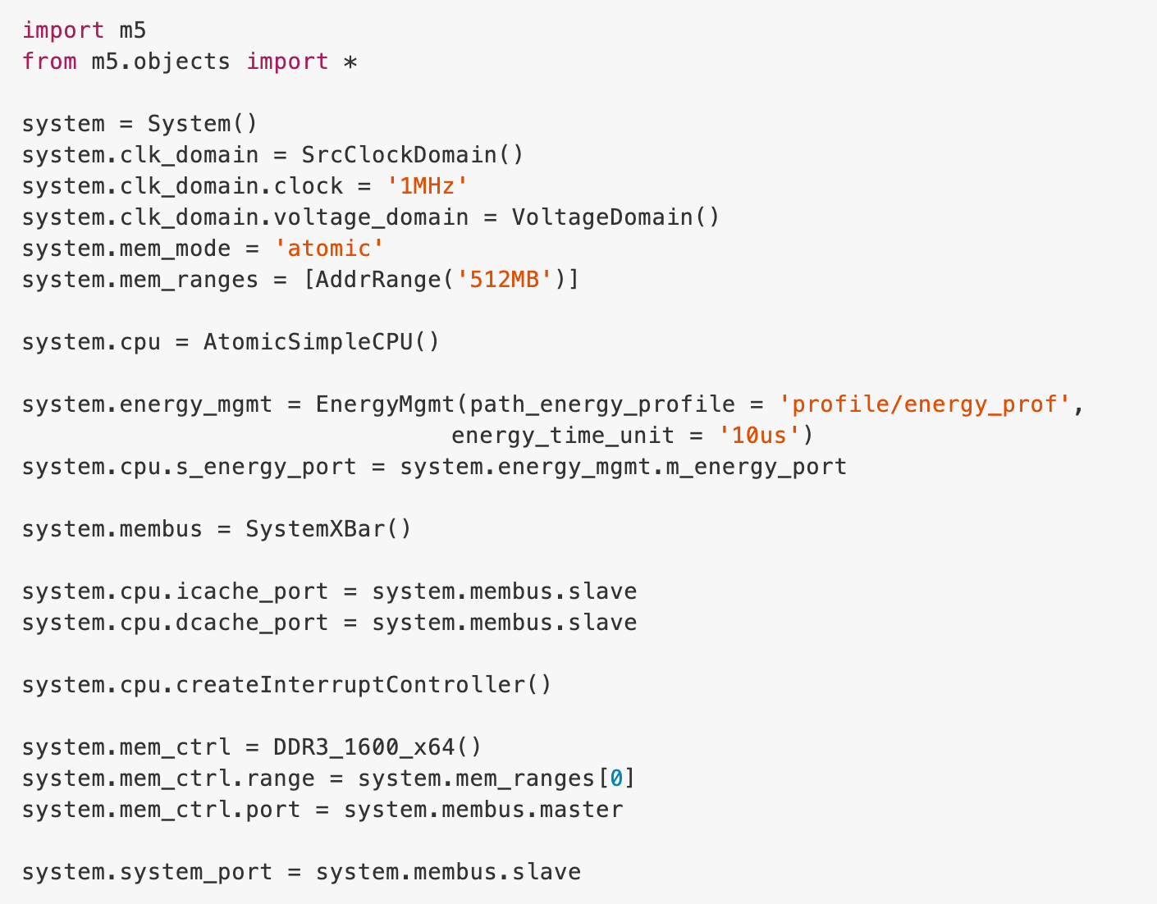
Put It Together
Configure the architecture

Slide 32
Put It Together
Add Energy Management Unit to the system

Slide 33
Simple Energy Management
Calculate all the energy consumption of each component and compare it to the energy trace
Use state machine to represent the state changing corresponding to the energy
If V < V_h: change to S_hibernating state

Slide 34
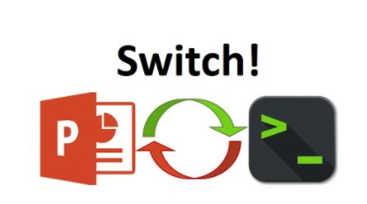
Demo

Slide 35
Reference
NVPSim:
https://github.com/polarpolar/gem5-nvpsim
Gem5:
http://learning.gem5.org/
http://doxygen.gem5.org/release/current/index.html
Pybind11:
https://github.com/pybind/pybind11
https://www.youtube.com/watch?v=YReJ3pSnNDo&ab_channel=NDCConferences
https://www.youtube.com/watch?v=jQedHfF1Jfw&ab_channel=EuroPythonConference
Scons:
https://scons.org/
Pvlib:
https://pvlib-python.readthedocs.io/en/stable/index.html

Slide 36
Last But Not Least

Slide 37
Q & A

Slide 38
Appendix - Related Works
Hardware-based
Ensuring idempotent: Clank
Software-based
Just-in-time checkpoint: Hibernus
Dynamic checkpoint: Chinchilla
Peripheral devices: KARMA
Codesign
Hide NVM latency: CoSpec

Slide 39
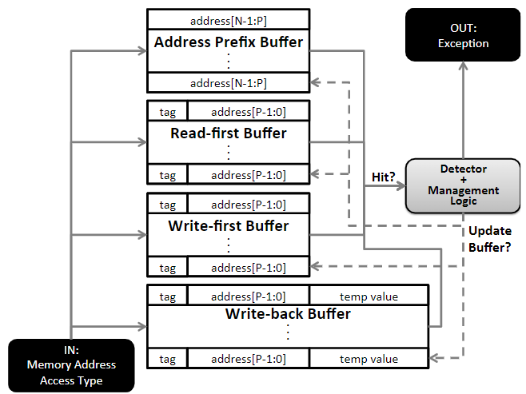
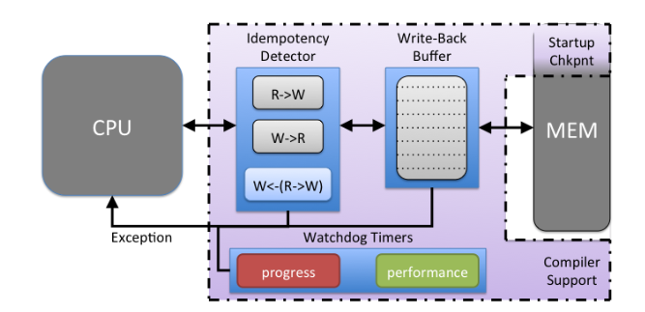
Clank
Use hardware buffer to ensure the idempotent execution ( avoid WAR problem)
Write-back buffer
Watchdog timer
Drawback: buffer size, NVM latency
[5] Clank: Architectural Support for Intermittent Computation

Slide 40
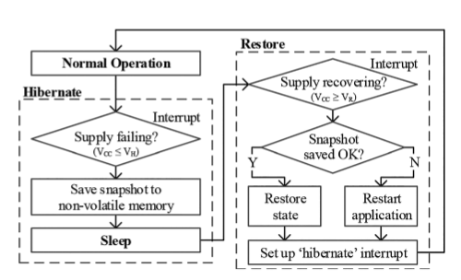
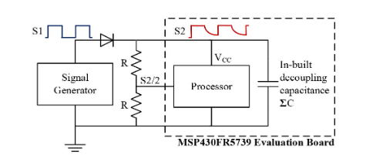
Hibernus
Use voltage detector to find out whether the voltage is under a certain threshold to make a checkpoint
Drawback: Frequent checkpoint
[1] Hibernus: Sustaining Computation During Intermittent Supply for Energy-Harvesting Systems

Slide 41
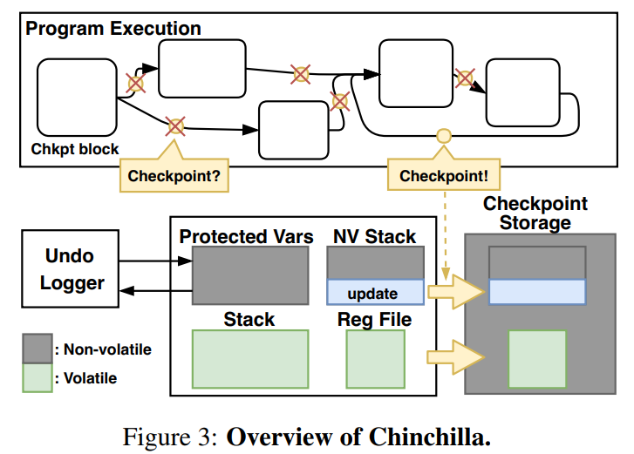
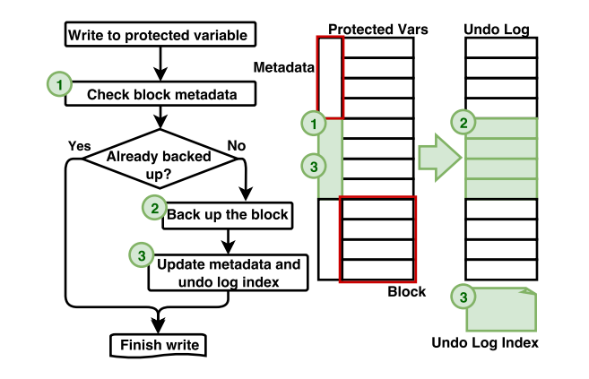
Chinchilla
Dynamically shrink the interval of checkpoints to reduce the overhead
Undo-logging to avoid WAR problem
Compiler support for divide program to terminal checkpoint blocks
[4] Adaptive Dynamic Checkpointing for Safe Efficient Intermittent Computing

Slide 42
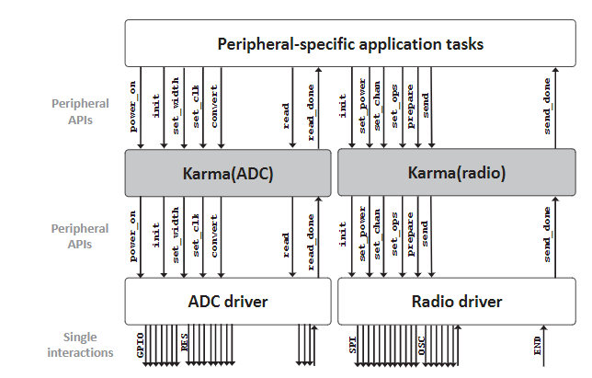
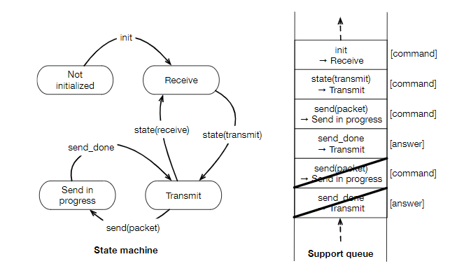
KARMA
Record peripheral devices’ state and APIs to make a checkpoint and restore.
Solve the inconsistency of CPU and I/O device state
[7] Intermittent Asynchronous Peripheral Operations

Slide 43
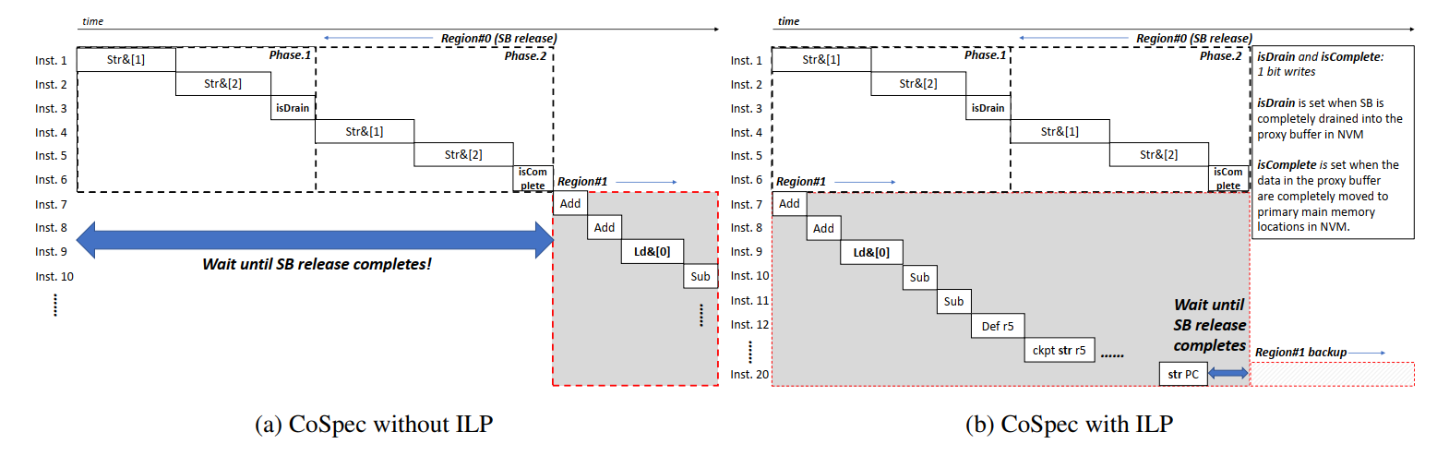
CoSpec
Use pipeline to hide the long NVM write latency and speculatively commit to NVM
Two phase commit to NVM
Compiler support
[7] CoSpec: Compiler Directed Speculative Intermittent Computation

